Slide 1


++++++
DEPARTMENT OF INFORMATION TECHNOLOGY
PROJECT TITLE
TRANSACTION INTEGRITY INSPECTION SYSTEM
using Machine Learning
TEAM MEMBERS
GUIDED BY
Mrs D.Ruba , M.Tech.,
(Assisstant Professor, IT)
RITHIKA B - 311421205071
SNEHA P - 311421205083
VAISHNAVI R - 311421205100

Slide 2
PROBLEM STATEMENT
Problem:
With the increasing use of online payment systems, fraudulent transactions have become a major concern, leading to financial losses and security threats.
Traditional fraud detection methods struggle to keep up with the evolving tactics of fraudsters, making them less effective.
This project aims to develop an intelligent machine learning-based fraud detection system that can efficiently classify transactions as legitimate or fraudulent.
Solution:
To tackle online payment fraud, we propose a machine learning-driven system capable of detecting fraudulent transactions in real time.
The solution includes data preprocessing, feature extraction, and model training using advanced algorithms such as Random Forest, SVM to ensure high accuracy.
Performance is further improved through hyper parameter tuning, while real-time monitoring swiftly identifies suspicious activities for immediate response.

Slide 3
ABSTRACT
Our project aims to create an intelligent fraud detection system for online payments using Machine Learning (ML). The system will analyze transaction data, such as amount, time, and user behavior, to identify patterns and anomalies that suggest fraud. It will employ various supervised learning algorithms, including Random Forest, Support Vector Machines (SVM) along with techniques like feature selection, data preprocessing, and anomaly detection to improve accuracy. To enable real-time fraud detection, the trained model will be deployed using frameworks like Flask or FastAPI, allowing seamless integration with online payment systems. A user-friendly dashboard will display transaction details and fraud alerts for monitoring. The project aims to reduce financial losses, enhance payment security, and build trust in online transactions. Future improvements may include incorporating deep learning and self-learning models for continuous enhancement of fraud detection capabilities.

Slide 4
INTRODUCTION
The rapid growth of online payment systems has made financial transactions more convenient but has also led to an increase in fraudulent activities, which pose serious risks to both businesses and consumers. Traditional fraud detection methods are often unable to keep up with the ever-evolving tactics of fraudsters, resulting in undetected fraud, financial losses, and security breaches. To address these challenges, this project aims to develop an intelligent fraud detection system that analyzes transaction data in real time to identify suspicious activities and differentiate between legitimate and fraudulent transactions. Unlike traditional, static rule-based methods, this system will use a dynamic approach, adapting to changing fraud patterns and continuously improving over time.
The system will incorporate advanced data processing and monitoring techniques to enhance the accuracy of fraud detection while reducing false alarms. By strengthening fraud prevention mechanisms, the system will improve the security of digital payment platforms, boosting user trust and protecting both financial assets and sensitive information from fraud.

Slide 5
LITERATURE SURVEY
S. NO | YEAR | AUTHORS | PAPER TITLE | METHODOLOGY | OUTCOMES
1 | 2023 | ABDULWAHAB ALI ALMAZROI AND NASIR AYUB | Online Payment Fraud Detection Model Using Machine Learning Techniques | JA to adjust weights and hyper parameters in the ResNeXt-GRU ensemble | the RXT-J, mainly exhibits the shortest execution time, demonstrating its efficiency.
2 | 2024 | M.N. Naga Keerthi,Saragada Nalini | Online payment fraud detection using machine learning | logistic regression, decision trees | The outputs are designed to support decision making processes, enhance security measures, and contribute to the ongoing refinement of fraud detection
3 | 2024 | Dia salama | Fraud_detection_ML: machine learning based on online payment fraud detection | Gradient boosting, k-NN, logistic regression | K-nn gives the best accuracy but it may works slow
4 | 2022 | M J madhurya, H L Gururaj, B C Soundarya K P vidyashree | Global transitions Proceedings | Naïve bayes algoritnm, decision tree algorithm | The neural network perform best results varied with folds
5 | 2023 | Dr.Yvan Lucas, Dr Johannes Jurgosky | Credit card fraud detection using machine learning :A survey | Data based methods, classifer based methods | fraud detection faces imbalance, evoling patterns and data limitations

Slide 6
Jjjjjjj j
EXISTING SYSTEM
Existing online payment fraud detection systems, while serving as the foundation of current security measures, are increasingly showing their age in the face of sophisticated and rapidly evolving fraud tactics. Primarily, these systems are built upon rule-based and statistical methodologies, each possessing inherent limitations.
Rule-based systems use predefined criteria, making them easy to implement but inflexible against evolving fraud tactics. Fraudsters can adapt and bypass these static rules, keeping such systems reactive.
Statistical methods use anomaly detection but struggle with modern fraud complexities. They are sensitive to data shifts, leading to false positives, and often miss sophisticated, coordinated fraud patterns.
DISADVANTAGES:
Inflexible to new fraud patterns
High false positive rates
Misses complex fraud schemes
Biased due to data imbalance
Not suitable for real-time detection

Slide 7
H
PROPOSED SYSYTEM
Our proposed system revolutionizes online payment fraud detection by implementing a real-time, adaptive machine learning framework. Unlike traditional rule-based systems that are easily circumvented by evolving fraud tactics, our approach leverages advanced algorithms, such as Random Forest and support vector machine (SVM) , to continuously learn from transaction data and identify complex fraud patterns.
ADVANTAGES:
• Enhanced Accuracy: Machine learning algorithms provide a higher accuracy rate in detecting fraud by learning from diverse data patterns.
• Real-time Detection: The system can identify and flag suspicious transactions in realtime, preventing potential fraud immediately.
• Adaptability: Continuous learning and model updates allow the system to adapt to new and emerging fraud techniques.
• Reduced False Positives: Advanced algorithms.

Slide 8
mmm
SOFTWARE AND HARDWARE REQUIRMENTS
SOFTWARE:
Development: Python (NumPy, Pandas, Scikit-learn, Matplotlib, Seaborn)
IDEs: VS Code, Google colab
Operating System: Windows
Database: SQLite
Deployment: Python Frameworks (Flask, FastAPI, Streamlit).
HARDWARE:
Development: Powerful workstation (multi-core CPU, ample RAM, SSD, optional GPU).
Deployment: High-performance servers, fast storage, robust network, database servers, load balancers..

Slide 9
litr
LITERATURE GAP ANALYSIS
LITERATURE GAP
Data Imbalance: Synthetic datasets help, but imbalanced class distribution still affects detection accuracy.
Overfitting Risk: Traditional models tend to overfit on training data, especially when tuned aggressively.
Feature Limitations: Standard techniques like PCA may fail to detect non-linear patterns in financial fraud.
Evolving Fraud Tactics: Static models struggle to maintain accuracy as fraud behaviors constantly change.
SOLVING GAPS WITH RANDOM FOREST & SVM
Random Forest: Handles missing data and outliers well; offers feature importance to reduce noise.
SVM : Effectively identifies complex, non-linear fraud patterns in transaction data.
Improved Generalization: Combining both models reduces overfitting and increases prediction robustness.
Adaptive Learning: The hybrid approach adapts better to evolving transaction behaviors over time.

Slide 10
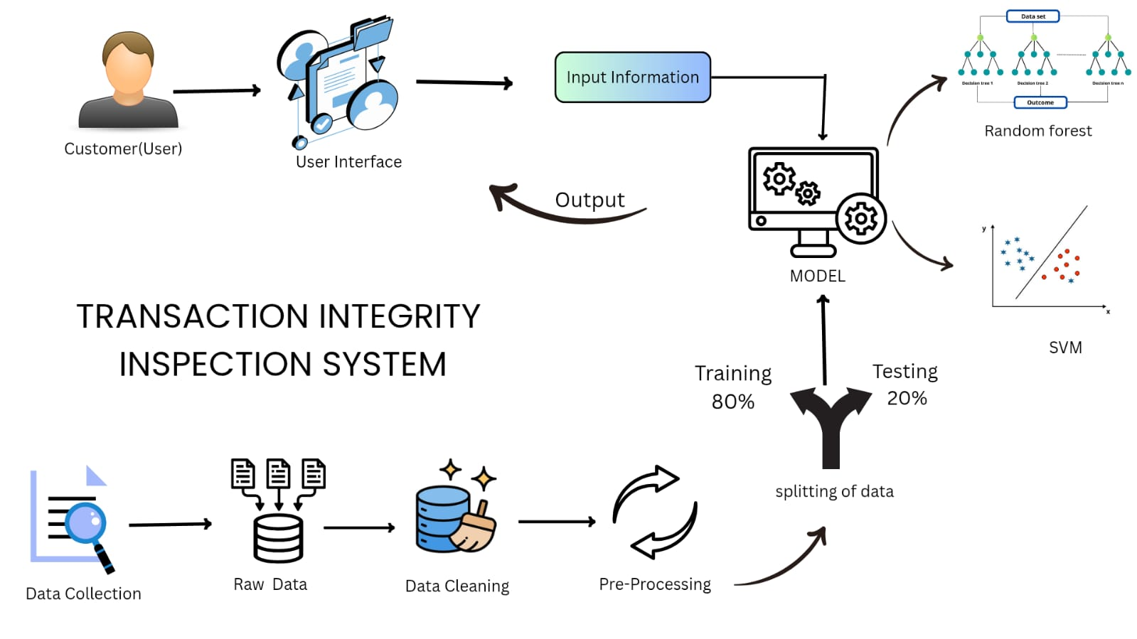
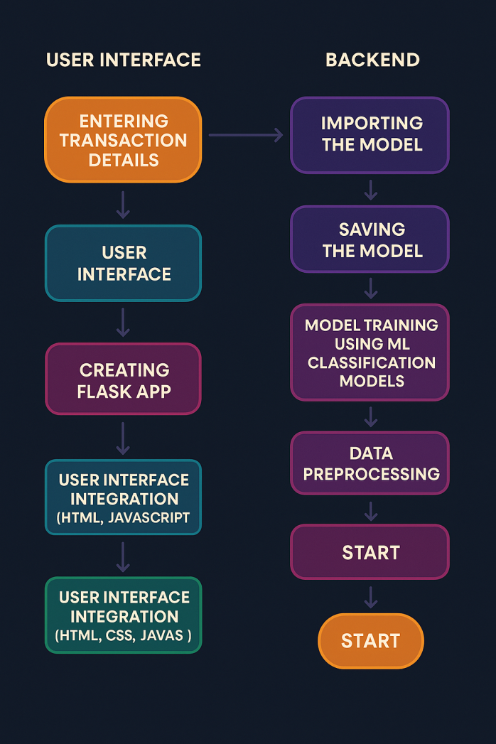
ARCHITECTURE DIAGRAM

Slide 11
\---++-------------------+-+--+++ -
MODULE 1
DATA COLLECTION :
Data collection is the process of gathering and measuring information from various sources to analyze and use for specific purposes, such as decision-making, research, or model training. Data for this analysis was sourced from the “Online Payments Fraud Detection Dataset” dataset on Kaggle.
The dataset includes: Step, Type, Amount, nameOrig, oldbalanceOrg, newbalanceOrig, nameDest, oldbalanceDest, newbalanceDest, and isFraud.
DATA CLEANING :
Data cleaning is the process of identifying and correcting errors or inconsistencies in a dataset to ensure quality and reliability.
Missing Values: Fill or remove null entries to avoid errors.
Duplicates: Eliminate repeated records to maintain accuracy.
Data Types: Correct column types (e.g., int, float) for consistency.
Outliers: Detect and manage unusual values that distort results.
Clean Data: Ensures reliable input for modeling and analysis.

Slide 12
MODULE 2
DATA VISUALIZATION :
Data visualization is essentially the graphical representation of information and data.
It's about taking raw data and turning it into visual elements like charts, graphs, and maps, to make it easier to understand.
Transaction Type: Some types more fraudulent (bar charts, pie charts).
Fraud vs. Legitimate: Imbalanced data needs balancing (bar charts).
DATA PREPROCESSING :
Dataset preprocessing is the stage where you transform raw data into a format suitable for machine learning models.
Normalization: Scale numerical features (Z-score or Min-Max).
Encode "Type": Use an Auto encoder to learn a compact numerical representation of
transaction types.
Balance Classes: Use SMOTE to create synthetic fraudulent transactions.
Reduce Features: Select key features for efficiency.
Split Data: Stratified split into train, validation, and test sets.

Slide 13
MODULE 3
MODEL BUILDING:
Model Selection
The Random Forest Classifier and support vector machine was selected for its high accuracy, ability to handle large and imbalanced datasets, and resistance to overfitting. As an ensemble method, it combines multiple decision trees to improve prediction stability and reliability, making it suitable for binary classification (fraud vs. non-fraud).
2. Model Training
The dataset was split into training and testing sets, typically using a 80:20 ratio. The model was trained on the training data, allowing it to learn meaningful patterns and relationships between transaction features and their corresponding fraud labels
.
3. Model Testing & Prediction
After training, the model was tested on unseen data (test set) to predict whether transactions were fraudulent.

Slide 14
MODULE 4
MODEL EVALUATION :
Model Evaluation is the process of assessing the performance of a machine learning model after training, to determine how well it makes predictions on new, unseen data. It helps in understanding the effectiveness of the model in solving the problem and is crucial for improving its performance.
Accuracy: Measures overall correctness of predictions.
Precision: Identifies the accuracy of fraud predictions.
Recall: Detects the ability to identify actual fraud cases.
F1-Score: Balances precision and recall for better fraud detection.
Confusion Matrix: Visualizes true positives, false positives, true negatives, and false negatives to assess errors.
SAVING THE MODEL :
Use Joblib or Pickle to store the trained model for future use.
Saves time by avoiding re-training and allows for easy integration in production (e.g., web apps using Flask or Streamlit).

Slide 15
MODULE 5
GENERATING USER INTERFACE :
The UI of the Fraud Detection System, built using Flask for the backend, allows users to input details such as Transaction ID, Receiver ID, Amount, and Payment Method. After submitting the information, users click the “Detect Fraud” button to trigger the fraud detection model.
The results are displayed with color-coded feedback (red for fraud, green for valid) and icons for clear understanding. Loading indicators show progress, and security prompts ensure data protection. HTML/CSS is used to customize the styling and create an intuitive, visually appealing interface.
The fraud detection model is built with Random Forest, and Joblib or Pickle is used to save and load the trained model. Pandas is used for data manipulation and preparing inputs for the model.

Slide 16
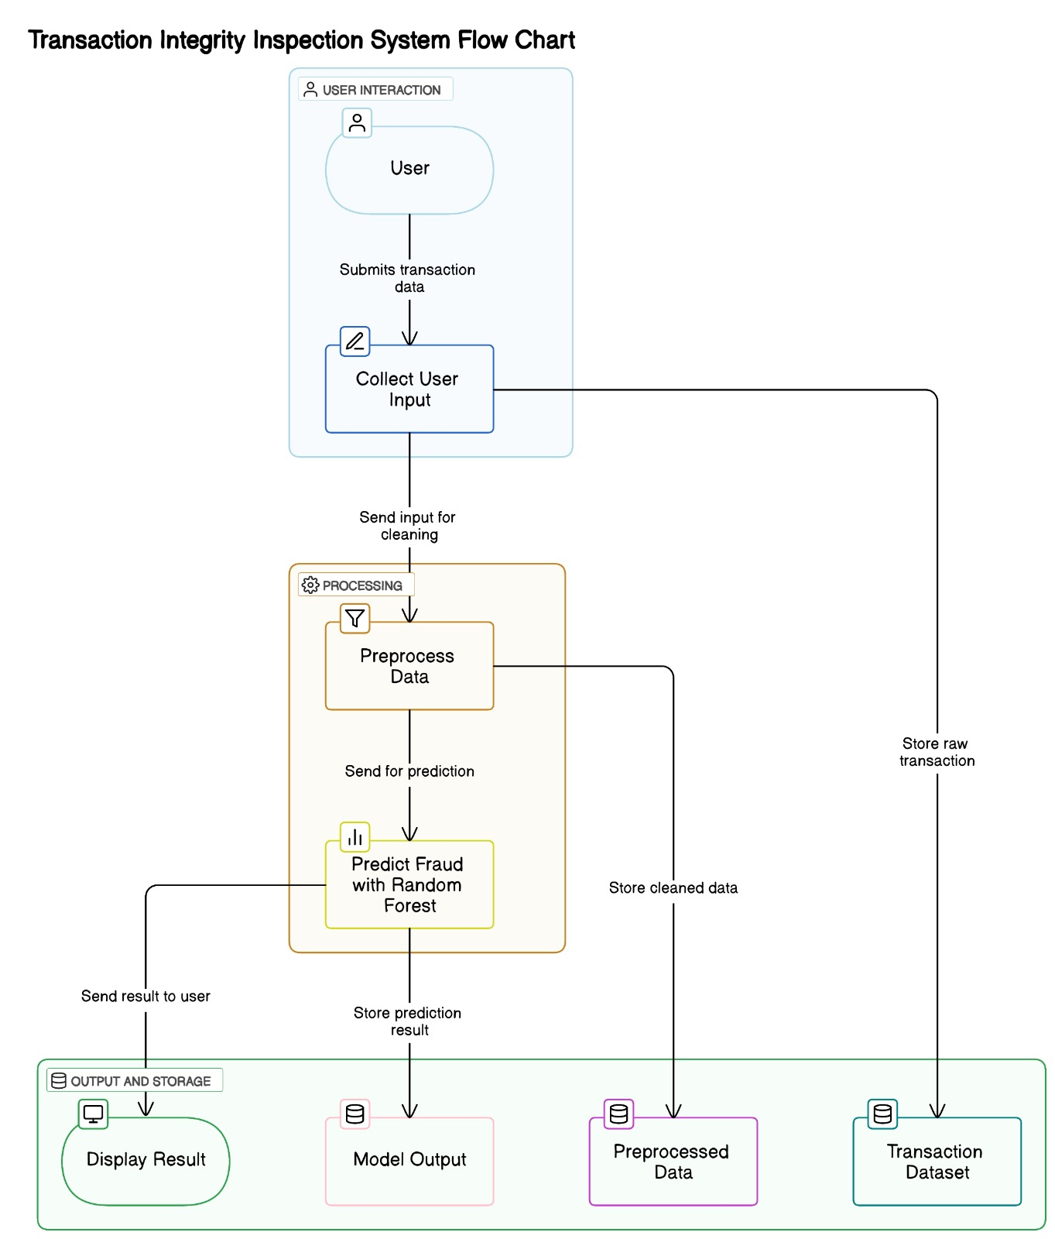
DATA FLOW DIAGRAM
A Data Flow Diagram (DFD) visually represents how data moves within a system, showing the processes, data stores, data flow, and external entities. It helps in understanding how information is processed, stored, and transferred.

Slide 17
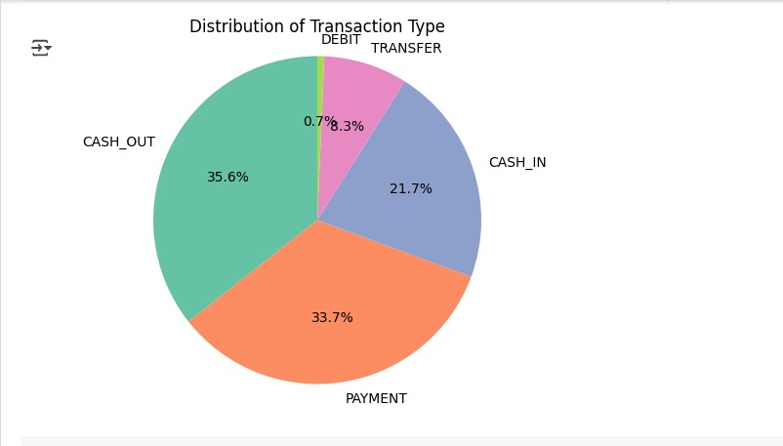
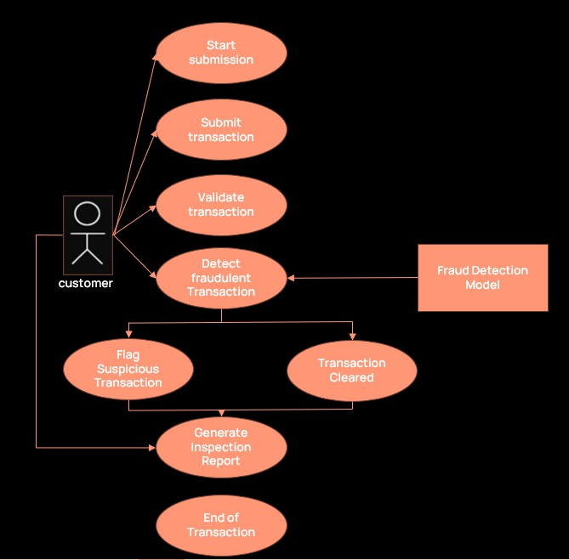
USE CASE DIAGRAM
Use case describes how a system or application interacts with users or other systems to achieve a specific goal. It outlines the primary functionality, actors involved, and the flow of events in a concise manner.

Slide 18
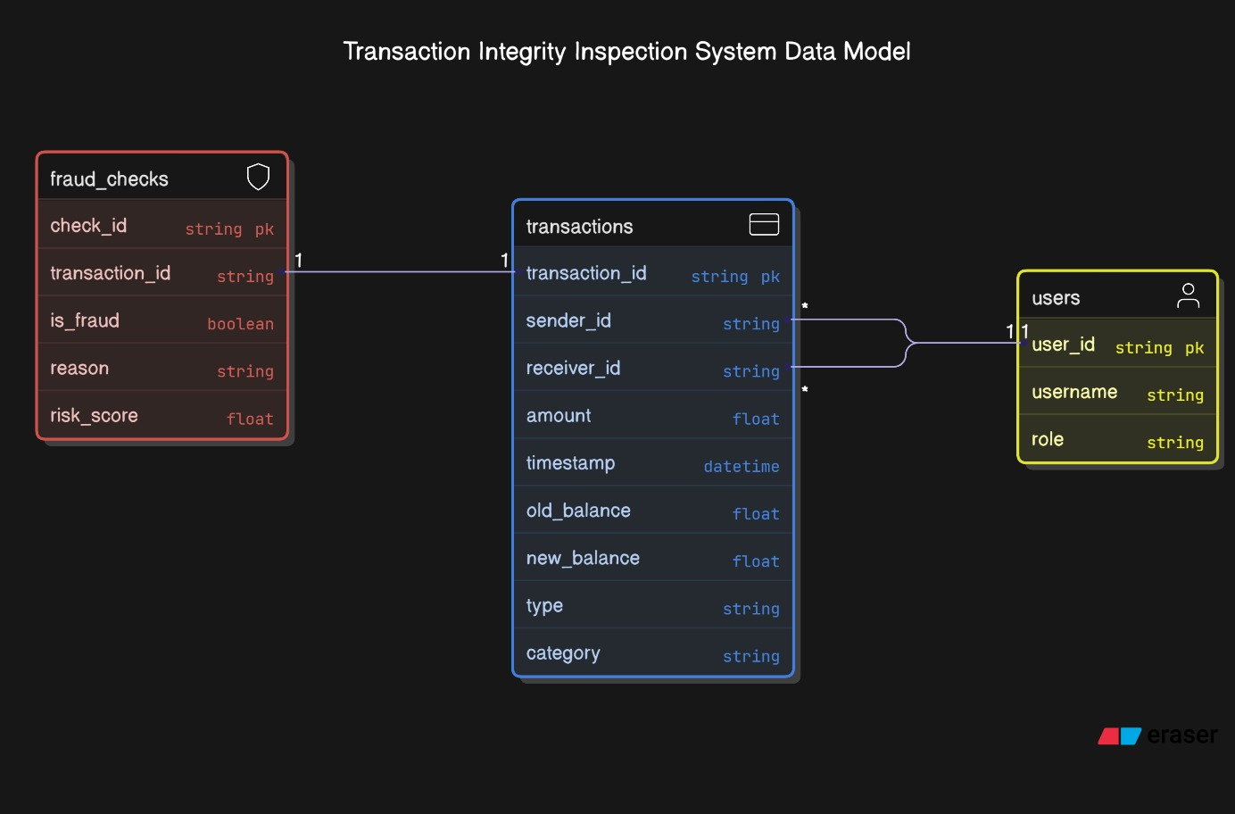
ENTITY RELATIONSHIP DIAGRAM
An Entity-Relationship Diagram (ERD) is used to visually represent the data model of your system by showing the entities (tables), their attributes (columns), and relationships between them.

Slide 19
ALGORITHM
Support Vector Machine (SVM)
SVM is a supervised machine learning algorithm used for classification and regression tasks. It works by finding the optimal hyperplane that best separates data into classes. SVM is effective in high-dimensional spaces and is especially powerful when the number of dimensions is greater than the number of samples. It uses kernel functions (like linear, polynomial, or RBF) to handle non-linear classification problems.
Random Forest
Random Forest is an ensemble learning algorithm that builds multiple decision trees and merges their results to improve accuracy and prevent overfitting. Each tree is trained on a random subset of data and features (bagging). The final prediction is made by majority voting (classification) or averaging (regression). It is known for its robustness, high accuracy, and ability to handle large datasets with missing or imbalanced data.

Slide 20
CONCLUSION
The Transaction Integrity Inspection System showcases the effective use of machine learning in identifying and mitigating fraudulent financial transactions. By leveraging data-driven models and an intuitive user interface, the system provides timely and reliable insights into transaction integrity. It not only improves fraud detection accuracy but also supports informed decision-making for financial security. The project emphasizes the critical role of AI in enhancing trust, transparency, and safety in digital financial systems, laying the groundwork for further innovations in secure transaction technologies.

Slide 21
FUTURE ENCHANCEMENT
Integrate deep learning algorithms to improve prediction accuracy.
Add behavioral pattern analysis to detect more complex fraud cases.
Introduce a user feedback system to continuously refine and update the model.
Enable multi-language support to reach a wider user base.
Develop a mobile-friendly interface for easy access on smart phones and tablets.
Incorporate cloud-based deployment for scalability and faster processing.
Add visual analytics dashboards for better fraud pattern visualization and insights.
Implement a real-time notification feature to alert users instantly about suspicious transactions or potential fraud.

Slide 22
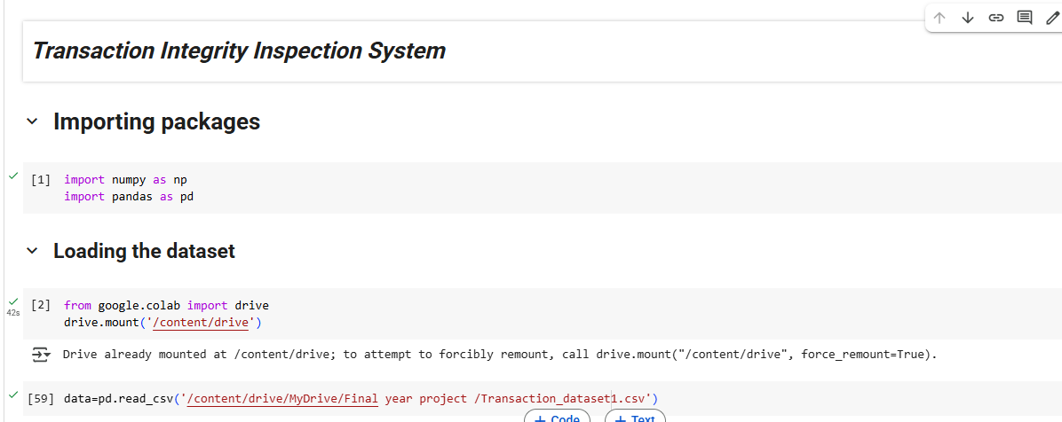
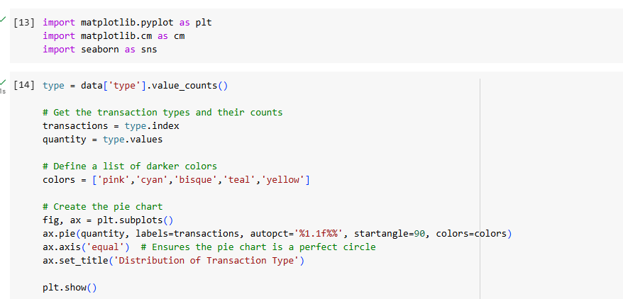
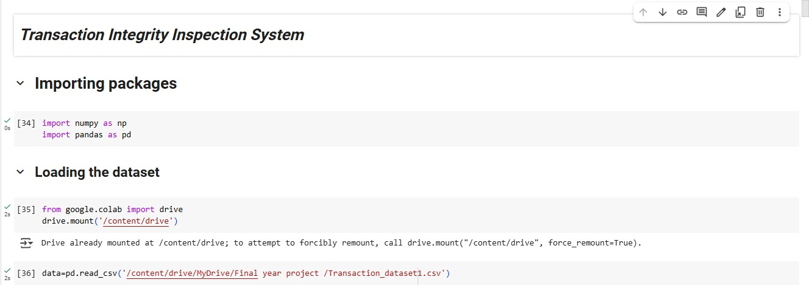
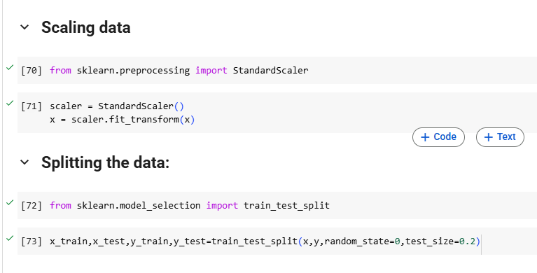
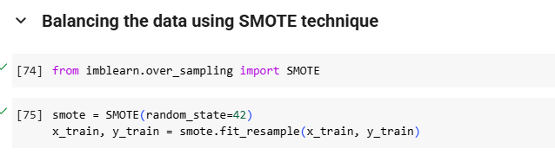
SAMPLE CODING

Slide 23
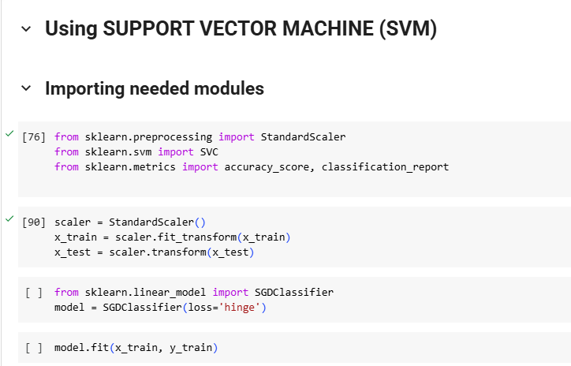
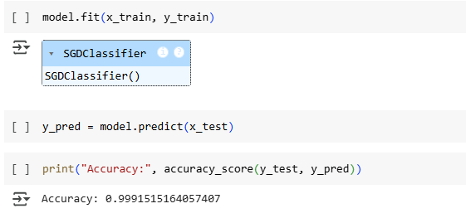
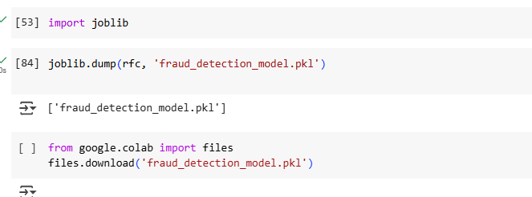
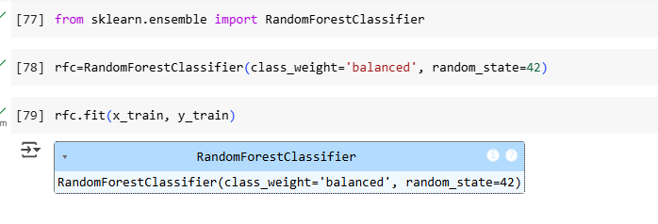

Slide 24
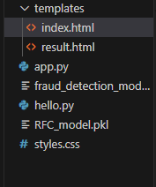
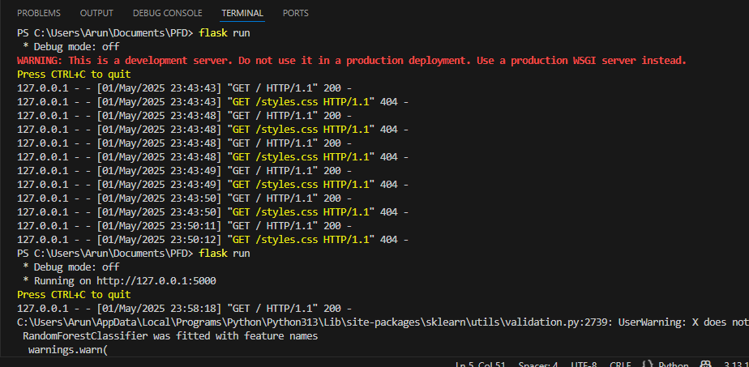

Slide 25
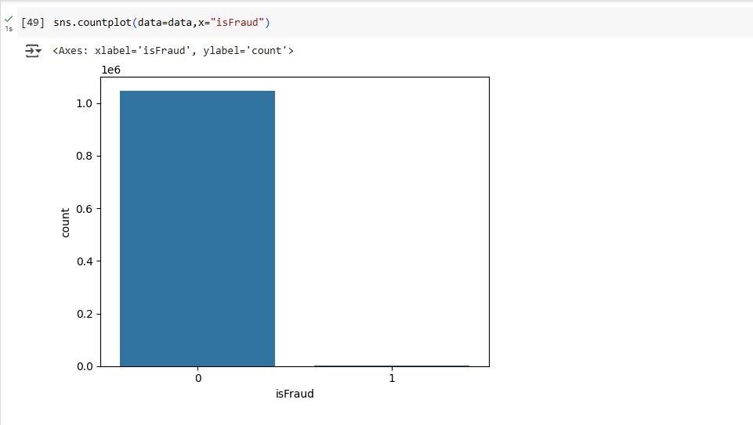
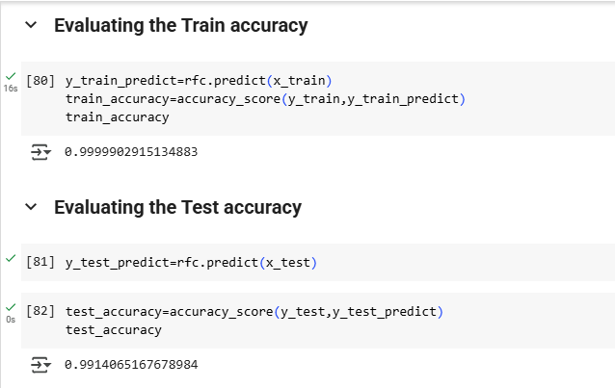
SAMPLE OUTPUT

Slide 26
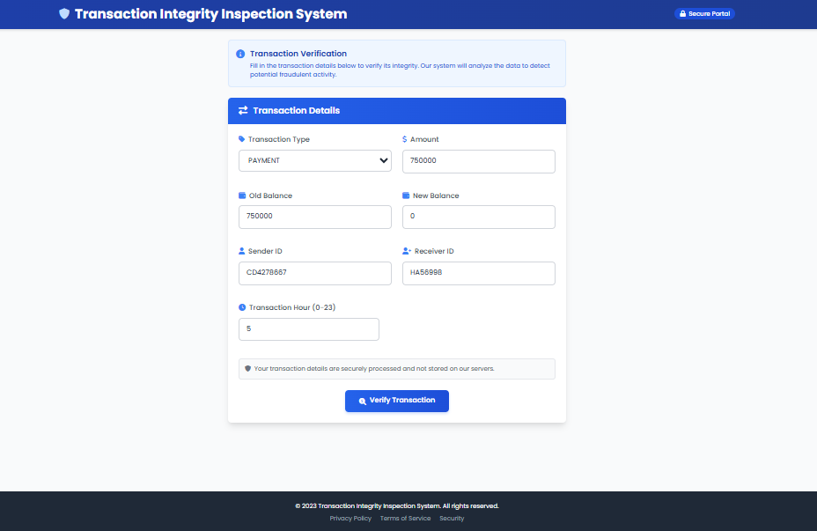

Slide 27
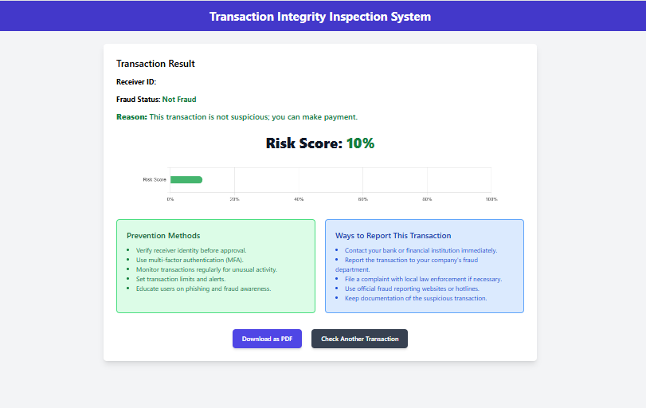
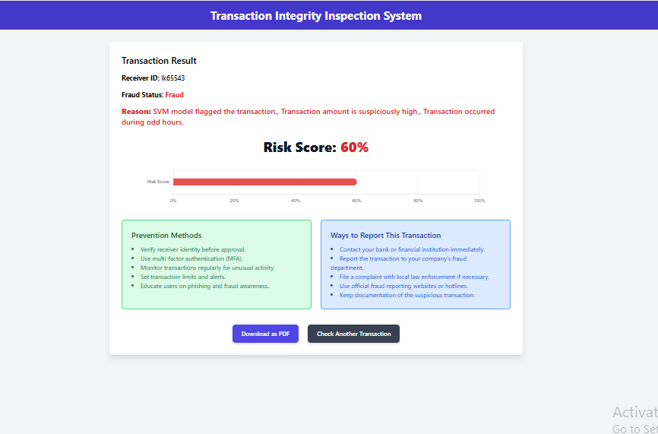

Slide 28
REFERENCES
Kyriienko, O., & MaAntonijevic, M., Stankovic, M., Zivkovic, M., Tanaskovic, M., & Bacanin, N. (2022). Tuning machine learning models using a group search firefly algorithm for credit card fraud detection.
Anitha, V., Siri, C., Meghana, K. S., Joshna, M., & Akanksha, G. (2025). A Survey on Online Payment Fraud Detection Techniques using Machine Learning gnusson, E. B. (2022). Unsupervised quantum machine learning for fraud detection.
Jovanovic, D., Algorithms.
Haritha, S., Shyama, P., & et al. (2021). Fraud detection in online payment systems using machine learning algorithms. International Journal of Advanced Research in Computer Science, 12(2), 32-37. slam, M. A., Kabir, M. H., & et al. (2021). A survey of machine learning techniques for fraud detection in financial transactions. Journal of King Saud University - Computer and Information Sciences Rodríguez Vaquero, P. (2023). Literature Review of Credit Card Fraud Detection with Machine Learning Methods.
Yaseen, Q., & Abuhasan, I. (2022). A Survey on Credit Card Fraud Detection Using Machine Learning Techniques.
Khan, S. A., Fattah, M. A., & et al. (2021). Real-time credit card fraud detection using machine learning techniques. Journal of Computational Science, 52, 101337
Usama, M., Farooq, A., & et al. (2021). Online payment fraud detection using supervised machine learning algorithms.
Singh, S., Singh, K., & et al. (2021). Deep learning approaches for fraud detection in financial transactions. Expert Systems with Applications, 184, 115439.
Chen, Y., Liu, M., & Li, H. (2023). Fraud detection in e-commerce using a hybrid machine learning model: A case study on online payment systems. Computers & Security, 119, 102748.
Kumar, R., & Sharma, A. (2023). Detecting fraudulent online payment transactions using a neural network-based approach. IEEE Access, 11, 57234-57245.

Slide 29
THANK YOU

